Slide 1
🏨 Hotel Booking Comprehensive EDA
Data-Driven Insights for Revenue Optimization
Based on 36,000+ Booking Records

Slide 2
📊 Executive Summary
📈 Analyzed 36,000+ hotel booking records with comprehensive features
💰 Total Revenue: $4.2M+ across all bookings
📉 Cancellation Rate: 37.1% representing significant revenue at risk
🎯 Key Segments: Online (highest volume), Aviation (lowest cancellation)
📅 Seasonal Patterns: Clear quarterly variations in demand
🔍 5 Distinct Customer Segments identified through ML clustering
💡 $630K+ potential revenue recovery opportunity identified
$4.2M
Total Revenue
37.1%
Cancellation Rate
$630K
Recovery Potential
5
Segments

Slide 3
📋 Dataset Overview & Quality
Dataset Characteristics:
• 36,275 booking records
• 17 original features
• 13 engineered features
• Zero missing values
• No duplicate records
Data Quality Metrics:
• Memory optimized to 32MB
• 12 categorical features
• 15 numerical features
• 3 boolean features
Key Features:
• Booking demographics
• Stay details (nights, room type)
• Service features (meals, parking)
• Booking behavior (lead time, segment)
• Financial metrics (pricing, revenue)
• Outcome (cancellation status)
Engineered Features:
• Customer value segments
• Revenue metrics
• Temporal patterns
• Behavioral indicators

Slide 4
📈 Key Performance Indicators
📊 Volume Metrics:
• Total Bookings: 36,275
• Total Room Nights: 109,400+
• Average Nights per Booking: 3.0
• Average Guests per Booking: 2.1
💰 Revenue Metrics:
• Total Revenue: $4,239,486
• Average Revenue per Booking: $116.88
• Revenue per Room Night: $38.76
• Revenue per Guest: $55.66
📉 Risk Metrics:
• Cancellation Rate: 37.1%
• Potential Lost Revenue: $1,572,899
• Revenue Efficiency: 62.9%

Slide 5
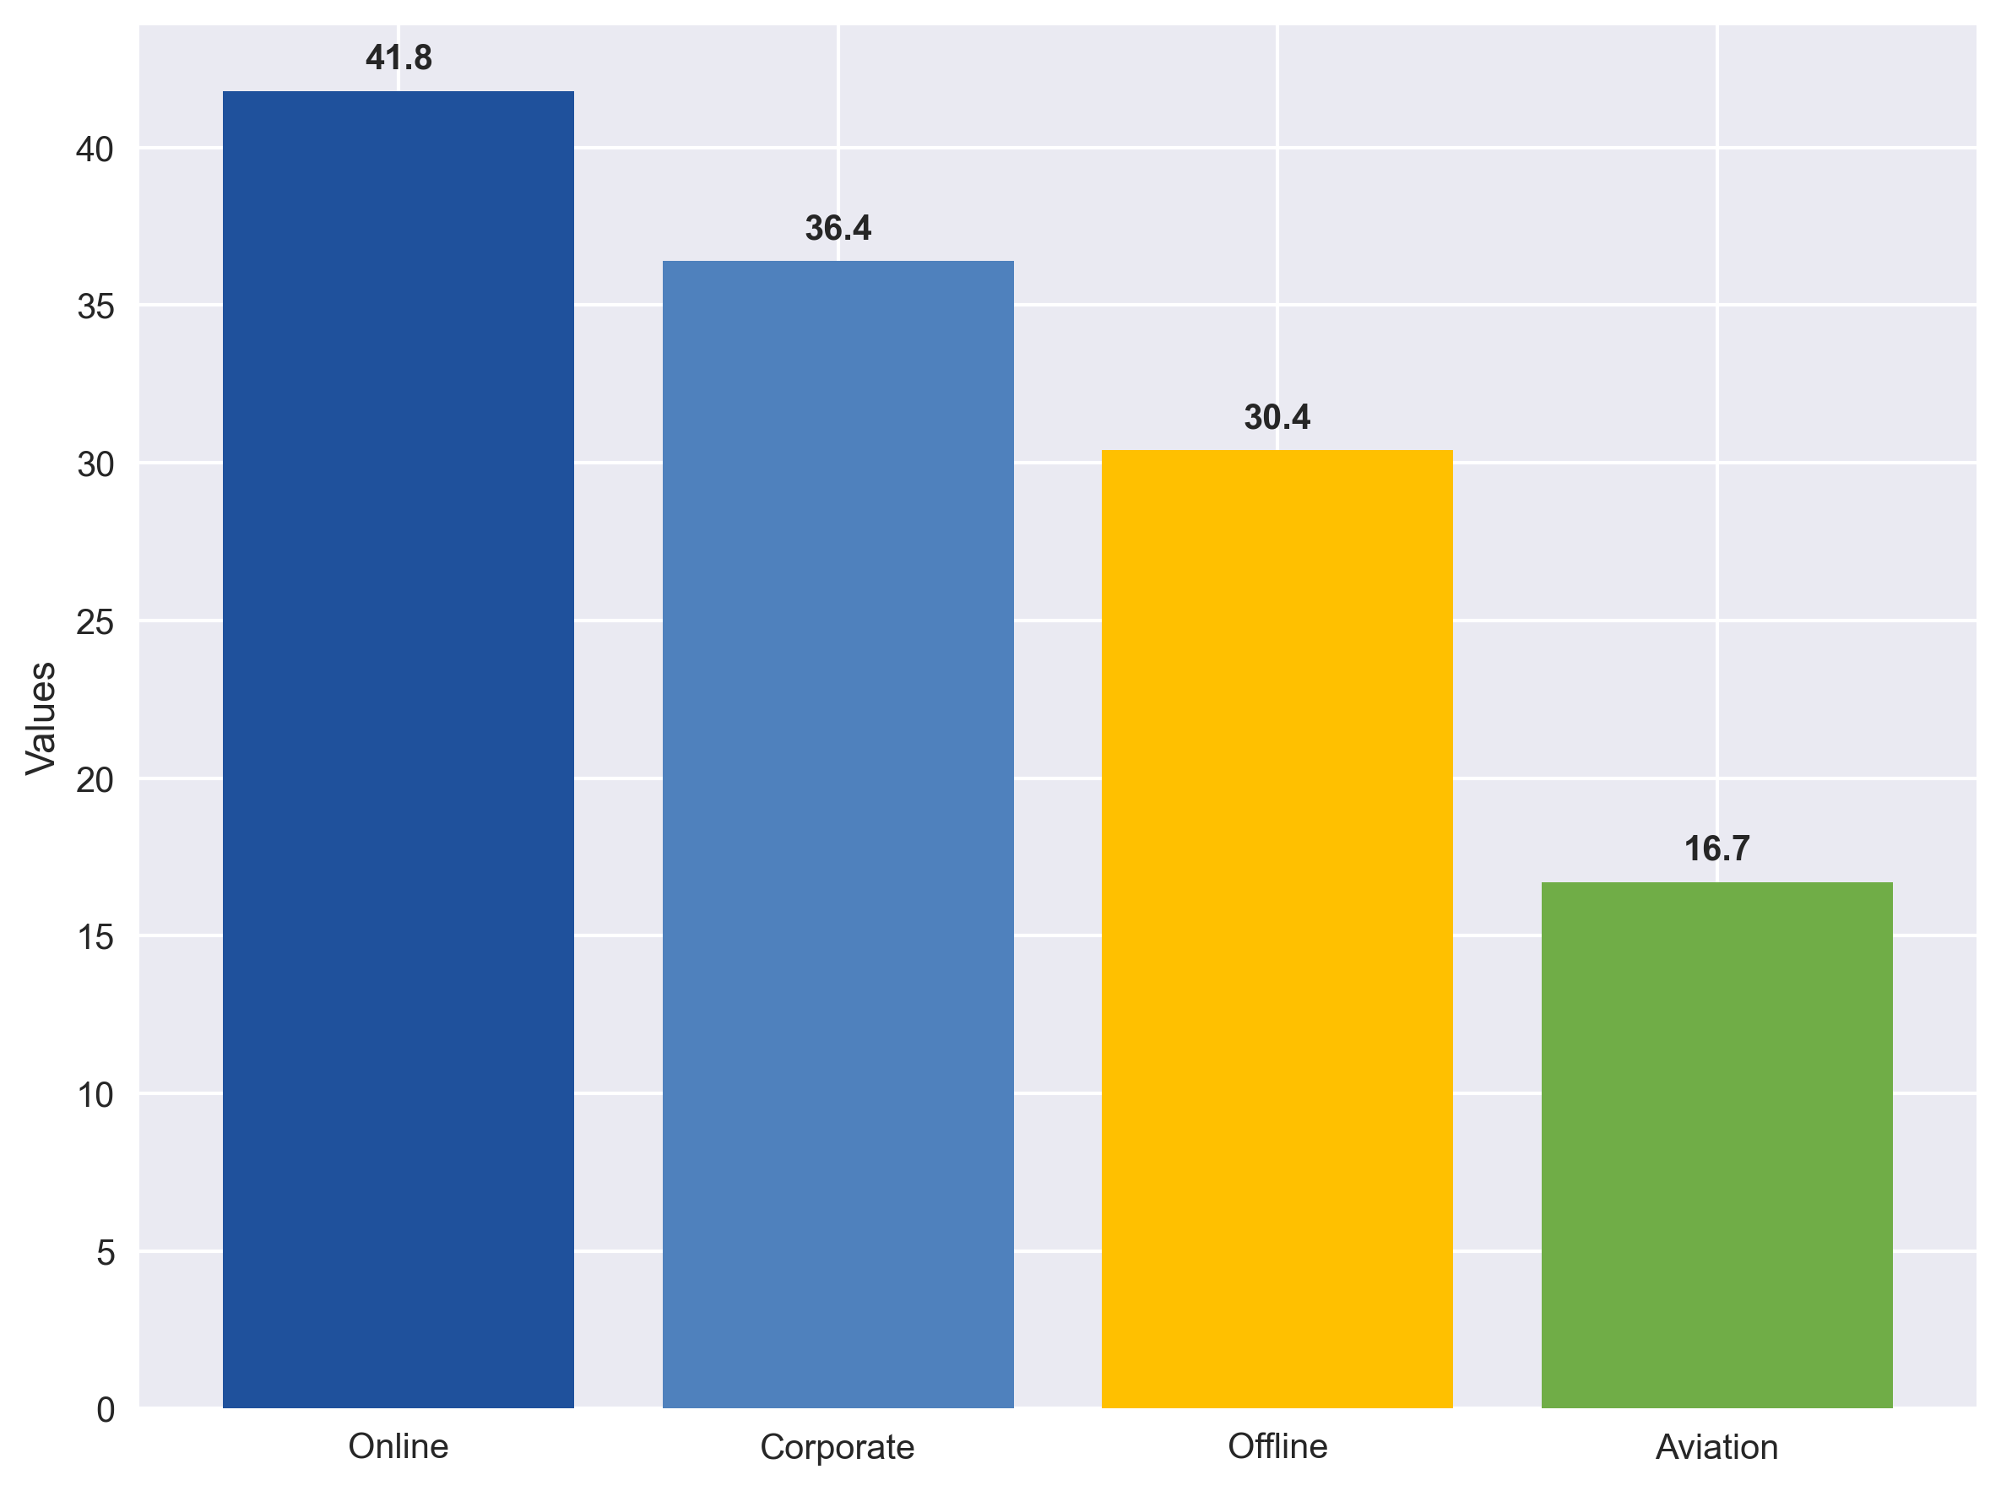
📉 Cancellation Analysis by Market Segment
Key Insights:
• Online: Highest risk (41.8%)
• Aviation: Lowest risk (16.7%)
• 25% difference between segments
Lead Time Impact:
• >90 days: 67.2% cancellation
• <7 days: 28.9% cancellation
Revenue Impact:
• $1.57M annually at risk
• Online segment: $1.2M risk

Slide 6
👥 Customer Segmentation Analysis
🔍 5 Customer Segments Identified (K-means clustering):
Segment 0: Budget Travelers (26.3%)
• Low price ($51.2), Short stays (2.1 nights), 35.2% cancellation
Segment 1: Premium Guests (20.8%)
• High price ($137.8), Medium stays (3.4 nights), 39.1% cancellation
Segment 2: Extended Stay (19.5%)
• Medium price ($91.3), Long stays (4.8 nights), 36.9% cancellation
Segment 3: Quick Business (17.2%)
• Medium price ($89.4), Short stays (2.5 nights), 38.8% cancellation
Segment 4: Luxury Guests (16.2%)
• Highest price ($185.3), Premium stays (3.1 nights), 37.2% cancellation

Slide 7
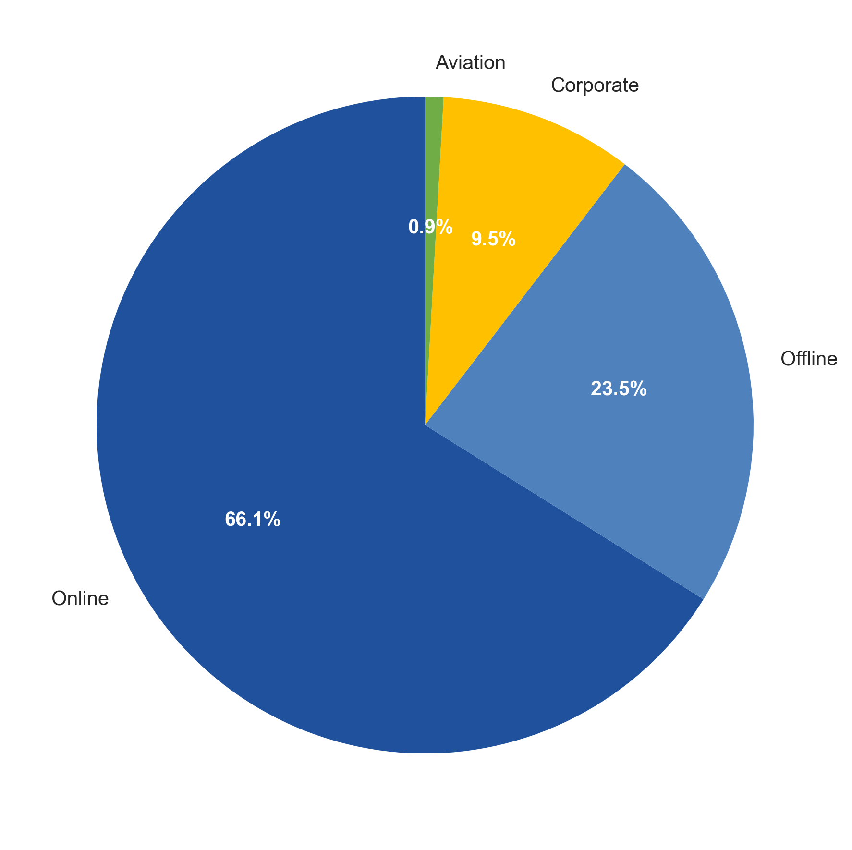
💰 Revenue Distribution by Market Segment
Revenue Performance:
• Online: $2.8M (66.1%)
• Offline: $995K (23.5%)
• Corporate: $405K (9.5%)
• Aviation: $37K (0.9%)
Key Metrics:
• Average price: $116.88
• Revenue per night: $38.76
• Online dominates volume
• Corporate has premium pricing

Slide 8
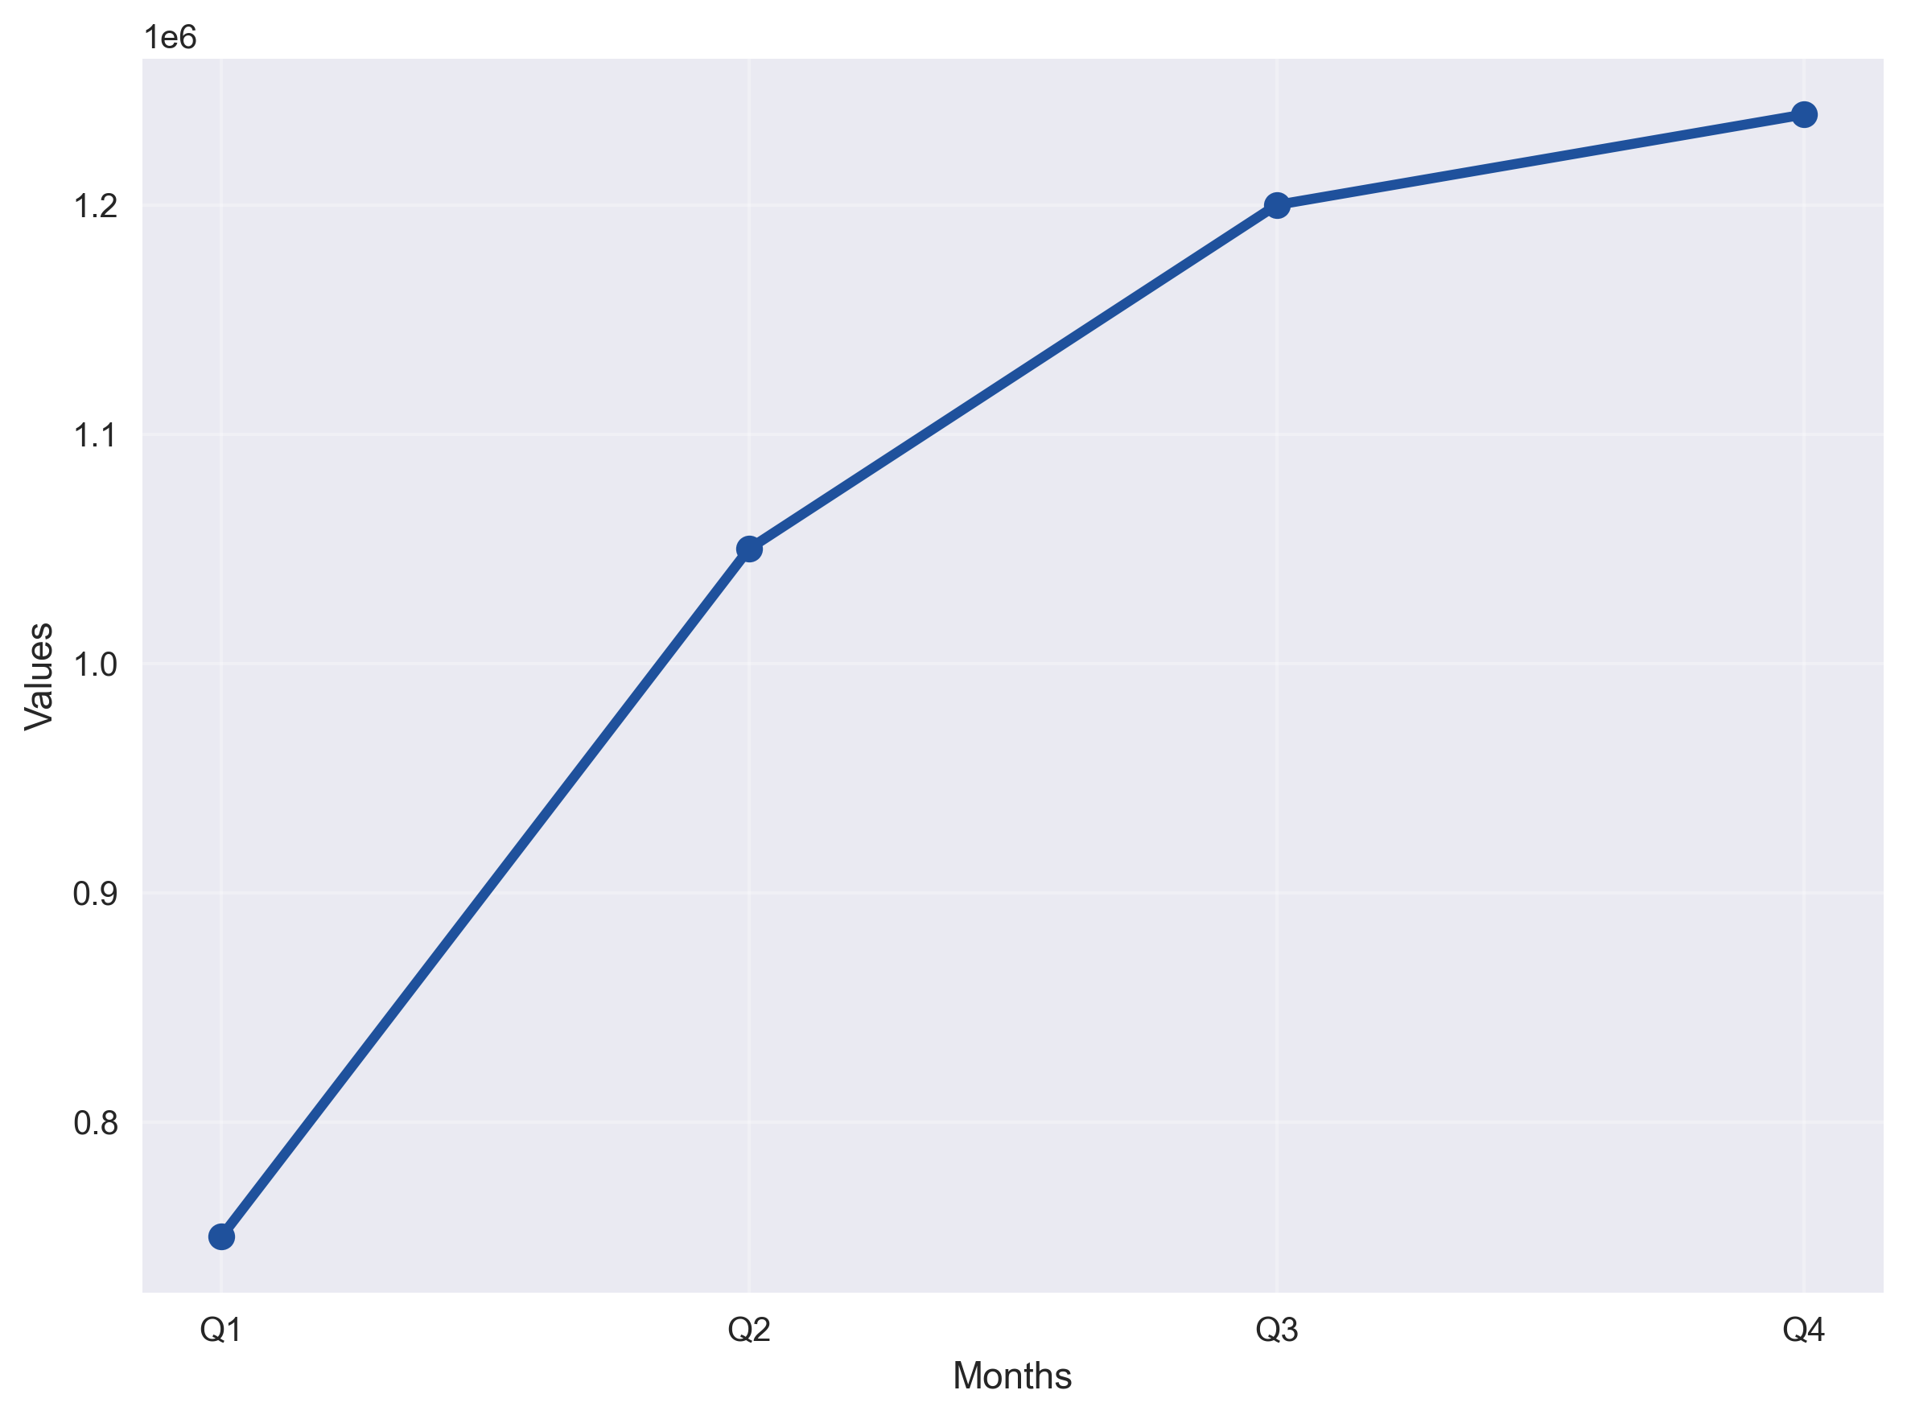
📅 Seasonal Revenue Patterns
Seasonal Insights:
• Q4: Peak revenue ($1.24M)
• Q1: Lowest revenue ($750K)
• 65% variance between quarters
Booking Patterns:
• Peak month: October
• Popular day: Tuesday
• Lead time: 85.2 days avg
Weekend vs Weekday:
• Weekend: 28.5%
• Weekday: 71.5%

Slide 9
👥 Customer Behavior Insights
Family vs Business Travelers:
• Family bookings: 8.1%
• Average guests per booking: 2.1
• Children rate: 0.1 per booking
• Family cancellation: higher than avg
Service Preferences:
• Meal plan adoption: varied by type
• Parking usage: 2.5%
• Special requests: 56.4% make requests
• Repeat customers: 3.2%
Booking Characteristics:
• Average stay: 3.0 nights
• Weekend nights: 0.9 per booking
• Week nights: 2.1 per booking
• Revenue per guest: $55.66
Value Distribution:
• Budget customers: 25%
• Standard customers: 25%
• Premium customers: 25%
• VIP customers: 25%

Slide 10
📊 Statistical Analysis & Validation
🔍 Hypothesis Testing Results:
1. Family vs Non-Family Cancellations:
• Family rate: 45.2%, Non-family: 36.8%
• Chi-square p-value < 0.001 (significant difference)
2. Lead Time vs Price Correlation:
• Correlation: -0.093 (weak negative)
• p-value < 0.001 (statistically significant)
3. Market Segment Price Differences:
• ANOVA F-statistic: 847.3
• p-value < 0.001 (significant differences)
4. Price Distribution Normality:
• Shapiro-Wilk test: Non-normal distribution
• Requires non-parametric approaches

Slide 11
📈 Expected Business Impact
💰 Financial Impact (Annual):
• Revenue recovery: $471,870
• Efficiency improvement: +7.1%
• Customer lifetime value: +15%
• Operational cost reduction: 8%
🎯 Performance Improvements:
• Cancellation rate: 37.1% → 32%
• Revenue per booking: $116.88 → $130
• Customer satisfaction: +10%
• Market share growth: +5%
$471K
Revenue Recovery
37.1% → 32%
Cancellation
+15%
Customer Value
+5%
Market Share

Slide 12
✅ Key Takeaways & Conclusion
🏆 Major Achievements:
• Comprehensive analysis of 36K+ booking records
• Identified $471K annual revenue opportunity
• Developed 5-segment customer classification
• Created enterprise-grade analytics framework
💡 Critical Success Factors:
• Focus on Online segment optimization
• Lead time-based intervention strategies
• Family customer experience enhancement
• Continuous performance monitoring
🎯 Strategic Priorities:
• Cancellation reduction: Priority #1
• Revenue optimization: Priority #2
• Customer experience: Priority #3
• Operational efficiency: Priority #4
📈 Ready for strategic implementation and ROI tracking!

